Slide 1



Ironhacker: Nikolaos Karras
Final project - Cars Dataset
Teacher: Felipe Rocha
Teacher Assistant: Cristian Castro Blua

Slide 2

Targets of the Final Project
Data analysis of the cars dataset
Exploring the data - Exploring the characteristics of cars using Business Intelligence tools
Use statistical methods, python libraries and different coding techniques
Building a machine learning model to predict the prices of cars based on features provided in the dataset
Comparing the accuracies of different models and finding the model that best fits our data
Understanding insights and trends in the dataset like which factors are responsible for higher car prices
Creating fictional scenarios
Visualizing the explored data

Slide 3
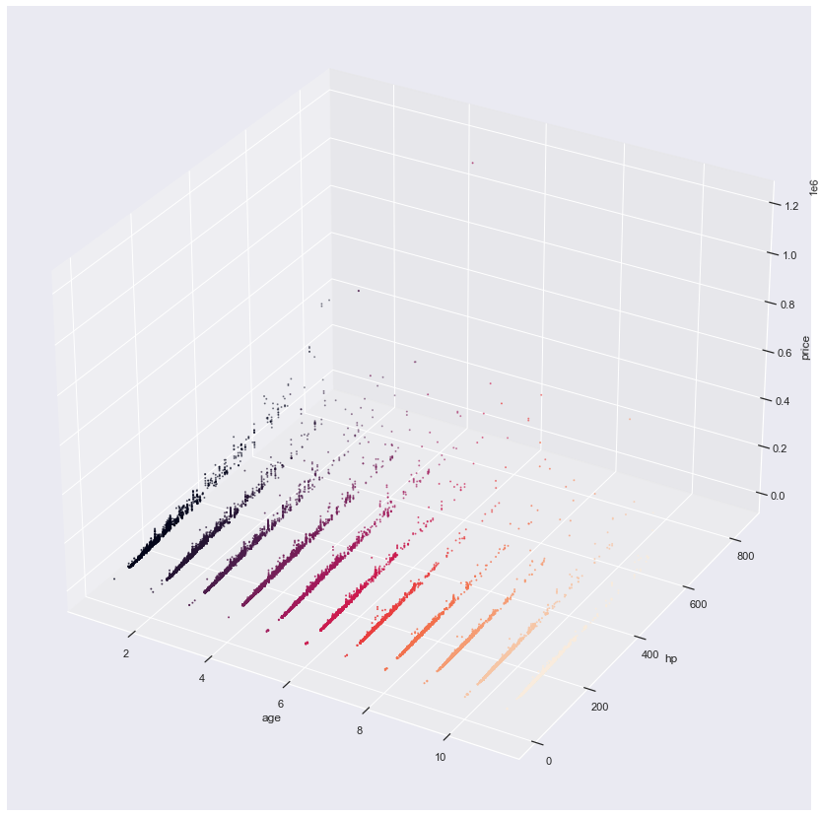
Data info and EDA (Exploratory Data Analysis)
Dataframe’s shape : (46405, 9)
Standardizing header-column names
creating a new column that has the age of every observation - dropping (or no use) column year
checking and dealing with NaN values: column model (143), column gearbox (182), column hp (29).
column gearbox: replacing NaN values with a new category ‘unknown’
columns model and hp: dropping the rows with NaN values
removing duplicate registrations - 44107 observations instead of 46236 (dataset without dropping NaN values)
finding the quantity of each observation in every column - feature with value_counts method
describing the dataframe after the NaN dealing (for numerical and categorical)
plotting different plots for the variables (pairplot, distribution plots, histograms, scatterplots, 3D plot, boxplots) – checking trends and insights

Slide 4
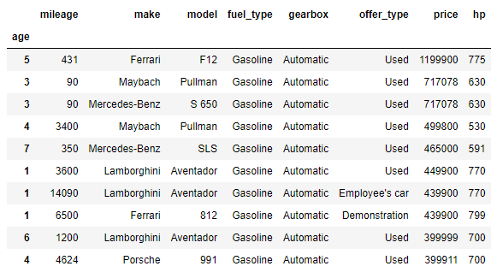
Creating scenarios
top 10 mileaged cars: Mercedes-Benz (5/10) and fuel type is Diesel (8/10), assuming that are more reliable.
top 10 most expensive cars: use gasoline, automatic gearbox,
little mileage, low age and high hp
top 10 hp cars: every car has an Automatic gearbox
checking opportunities for used cars (good characteristics - low prices)
(price< 10000, mileage < 50000, offer type: Used, hp > 100, age <= 5) :
27 opportunities (12 Opel, 7 Ford, 2 Fiat and Hyundai, 1 Lada, Mitsubishi, Renault, Citroen)
average price per make

Slide 5
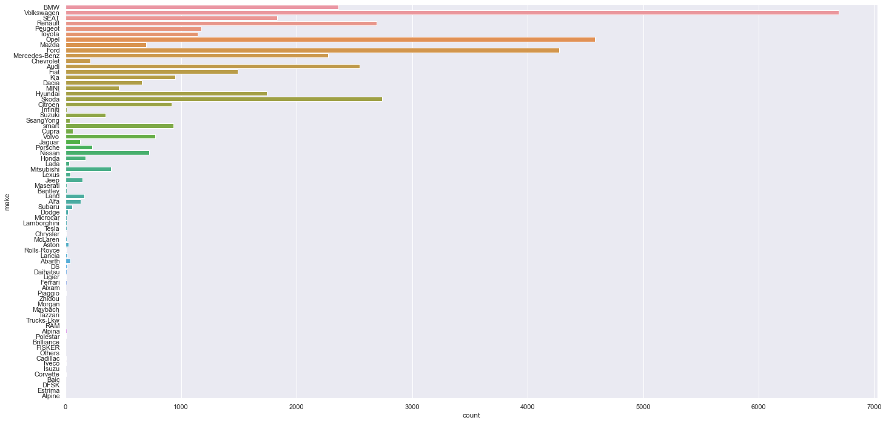
the case study of Volkswagen (VW) – trends in VW cars
Calculating useful information for the VW manager – also using queries in mySQL and Tableau like:
Summary of VW cars: 6693.
Summary of VW Golf cars: 1453.
Plotting make countplot, best-selling cars make is Volkswagen (in 2021, the Volkswagen Golf, T-Roc, and Tiguan were the best-selling car models in Germany).
Creating a dataframe with VW cars, describing it and checking trends by plotting:
Finding cheap opportunities for the Volkswagen best seller cars: Golf, T-Roc, and Tiguan

Slide 6
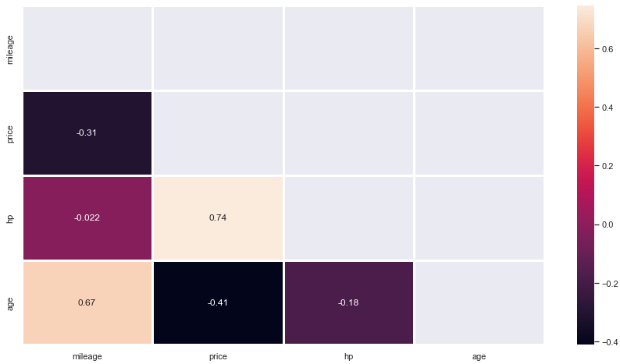
Correlations matrix for numerical
Target: column price
correlation values for numerical columns with the column 'price‘ in descending order
Price: 1.000000
Hp: 0.744893 -> strong correlation
Mileage: - 0.305364 -> weak correlation
Age: - 0.411495 -> weak correlation
no multicollinearity between the features (one-to-one) as there is no correlation greater than 0.85

Slide 7

Build a (benchmark) Model
Process:
splitting every column except the target in numerical and categorical
using dummies for the categorical features
concatenating numerical part and dummies
X-y split
Train-test split
Apply linear regression
Model Validation - Metrics (𝑅² score - MSE (Mean Squared Error) - RMSE (Root Mean Squared Error) - MAE (Mean absolute error))

Slide 8
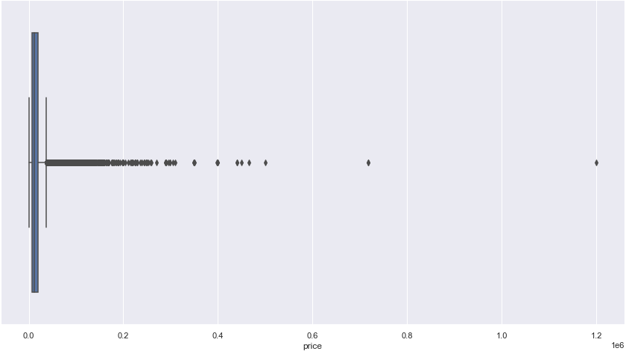
Trying different models and techniques
From price boxplot we notice:
presence of huge outliers, skewed distribution and high density in low prices.
also proved by calculating some percentiles:
75th: 19490, 90th: 32490 , 95th : 42450, 99th: 83417.18, max price: 1199900
Creating the processed dataset
Removing outliers - Creating a new dataframe with price < 95th percentile
=>
deducting the features from the dummies
Bucketing the columns: make, model, with logical thresholds (make:35, model:20)
=>
reducing columns after encoding (from 931 to 328)
Model Validation: 0.902300597136 (and stable)
Trying scaling the numerical part, KNN-K Nearest Neighbors and Random Forest

Slide 9
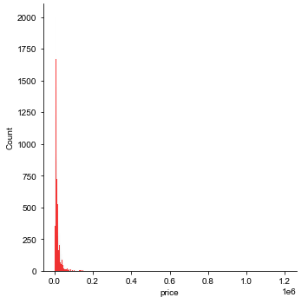
Limitations of the model
Difficulty to predict the prices of extreme outliers – extreme outliers aren’t a representative sample
Issue: huge outliers affect the Linear regression - big range of potential scores - metrics →
Solution: dropping the extreme outliers (over the 95th percentile) - smaller price range
Issue: outliers (in general) are a representative sample and also have a small impact in Linear regression →
Solution: bucketing the outliers and deducting the amount of columns after encoding – reducing the dimensions of the model and using different techniques of scaling

Slide 10

Model Validation - 𝑅² score
Model Validation - 𝑅² score
Initial dataset (with outliers) |  | processed dataset (without outliers and bucketed)
Linear Regression | Random Forest | Min-Max scaling Linear Regression | Standar scaling Linear Regression | Normalization Linear Regression | K Nearest Neighbors (k=3) | Random Forest – Scaled by MinMax Scaler (best approach)
* | * | 0.902 | 0.902 | 0.682 | 0.914 | 0.938 (best score)
* When we retry the benchmark model, we get different r2 scores in a really big range from really big negative numbers that show us the model is bad, till almost 0.92 that show us the model is a nice model which could be improved, these different r2 scores depend on the train and test subsets in test-train splitting and I believe that the reason of the big range (of r2 scores) is the huge outliers, combined with the big amount of columns after concatenating numerical part with dummies.

Slide 11
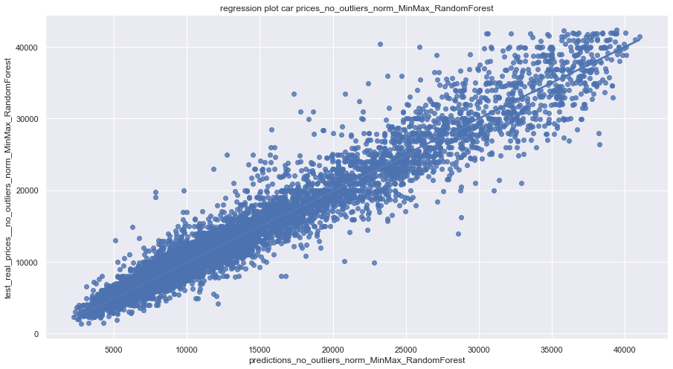
Conclusions
High score, good and more stable metrics when we fit the linear regression in the processed dataset (without outliers and bucketed) in combination with scaling
Best approach: Combination of Random Forest in the processed (without outliers and bucketed) dataset + MinMax scaling the numerical part
R2 score | 0.938
RMSE | 46.208
MAE | 1432.703
MSE | 2135.204

Slide 12
Conclusions - insights
Price vs.
Hp: The biggest impact in prices (from numerical) has the column hp: 0.744893 according to the correlations matrix. (Follows a polynomial line - distribution, the score is 0,61 for k=3). As the hp increases, the price increases as well and vice versa
Mileage: The distribution seems to be negative exponential. As the mileage increases, the price decreases and vice versa.
Fuel type: Electric/Diesel and Hydrogen cars seems to be more expensive than the others and LPG, CNG and ethanol cars are cheaper than the rest. Ethanol (2 cars), Hydrogen (1 car) are not representative samples.
Gear type: the automatic cars have almost triple average price from the other categories (manual and semi-automatic)
Makes and models: makes and models affect the car prices (brand name, reliability etc.) (Maybach avg price: 608439 - Daihatsu avg price: 4927)
Age: new cars are more expensive than the other categories on average, as we expected. If we were candidate buyers of a car and we were looking for cheap opportunities, then we should check cars from the year 2016, because the distance between the point of the average price in 2016 and the line is the biggest distance we meet under the linear regression.

Slide 13
Any other future ideas?
Trying:
Scaling with different methods (for example box cox transformation), making log the price
Using a, b tests
Clustering
Web scraping and then ANOVA to compare the means of the two datasets
VIF
PCA
a Classification Model by bucketing prices to check if a car is cheap, moderate or expensive

Slide 14
Thank you Eυχαριστώ Gracias Obrigado Grazie Danke धन्यवाद (dhanyavaad) با تشکر

